Slide 1
COL874 Advanced Compiler Techniques
Modules 141-145
Presented by: Jai Arora

Slide 2
Lec-141: Affine Space Partitions
Data dependencies exist across different iterations of the first loop
Possible to transform the axes of the program to exploit Synchronization Free Parallelization
Iterations of the outer loop in the transformed program can be done in parallel
Why? Because there are no data dependencies across different values of k
Increased locality due to the transformation as we decrease the reuse distance

Slide 3
Data Dependence Constraints
If these constraints yield No Solution, then there is no data dependence across different values of k for the given pair of static accesses
Check this for all possible pairs of static accesses (including self pairings)
If the conditions are satisfied: the loop has 1 degree of parallelism (1 level of loop nest that can be parallelized)

Slide 4
Degrees of parallelism
A loop nest has k degrees of parallelism if it has, within the nest, k parallelizable for loops
Can create O(n^{k}) parallel virtual processors
2 degrees of parallelism

Slide 5
Affine Space Partitions
Affine Function
Iteration-Space
l-dim
Processor-space
k-dim
l $≥$ k: it is a many-to-one map, and a function (maps all the iterations)
Need to use as many as (virtual) processors
Partition: All the iterations in the partition are mapped to the same processor
Constraint: This map needs to be an affine function

Slide 6
Affine Space Partitions
No data dependency
Can have O(2n) virtual processors
Our analysis should be able to exploit this
Each 3AC statement (static access) is analyzed separately for maximum parallelism

Slide 7
Lec-142: Space Partition Constraints
$$pid=Ci+c$$
(C, c) are different for each statement s
Variation: Could have a piecewise affine function instead of an affine function
Piecewise affine functions can be solved using polyhedral analysis (potentially giving better results)
Tradeoff: Performance vs Cost
Restrict ourselves to Affine functions

Slide 8
Space Partition Constraints
Need to find a solution to (C, c) satisfying data dependency constraints
Trivial Solution: $C= \left(0 0 …0\right)$ and $c= \left(0\right)$
Represents a zero-dimensional processor space
Everything mapped to the same processor
Valid solution but not very useful due to no parallelism
Also need to maximize the processor space dimension / rank of C
Affine Partition: a (C, c) solution for each statement s represents an Affine partition

Slide 9
Space Partition Constraints
Data dependent iterations are mapped to the same processor
Unknowns: C₁, c₁, C₂, c₂

Slide 10
Space Partition Constraints
Iteration-Spaces
Processor-space
Data dependence could be across the same statement or different statements
Chose these unknowns such that the constraints are satisfied, and the ranks are maximized

Slide 11
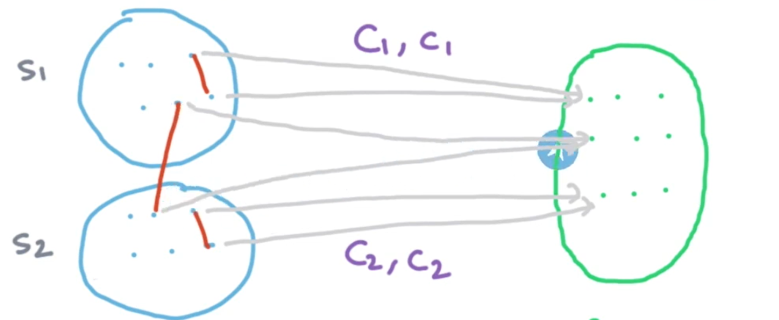
Lec-143: Maximum Rank Affine Partition
Affine Partitions help us to argue about the processors, iterations and the data in a homogeneous way
Trivial Solution: C₁ = 0, c₁ = 0, C₂ = 0, c₂ = 0
But no parallelism

Slide 12
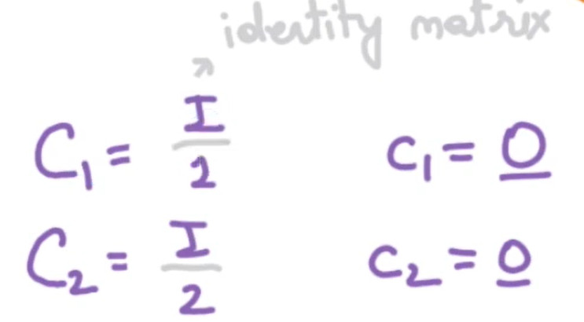
Maximum Rank Affine Partition
Max Rank Solution:
Desirable, but may not satisfy Data dependency constraints
Interested in the Max Rank solution satisfying the data dependence constraints

Slide 13
Max Rank constraints

Slide 14
Space Partitioning Example
Running Example:
Six Statements (one for each access); two writes
Data dependences:
X[i, j] $↔$ X[i, j] (both R/W)
X[i, j] $↔$ X[i, j-1]
Y[i, j] $↔$ Y[i, j] (both R/W)
Y[i, j] $↔$ Y[i-1, j]

Slide 15
Space Partitioning Example
X[i, j] with itself won’t have any space partitioning because [i, j] is a full rank access
X[i, j] = X[i, j] + Y[i-1, j]: we do have a data dependency, but in the same iteration
No meaningful constraints
We need only 2 affine functions, one for each C-statement (based on scalar dependencies)

Slide 16
Space Partitioning Example
All the dependent iterations should be mapped to the same processor
Disjoint chains are formed
Could map each of the chains to a separate processor
Need to find C₁, c₁, C₂, c₂ such that each chain is mapped to the same processor
Answer: 1-D mapping for each statement
P₁ = i – j -1 for s₁
P₂ = i – j for s₂

Slide 17
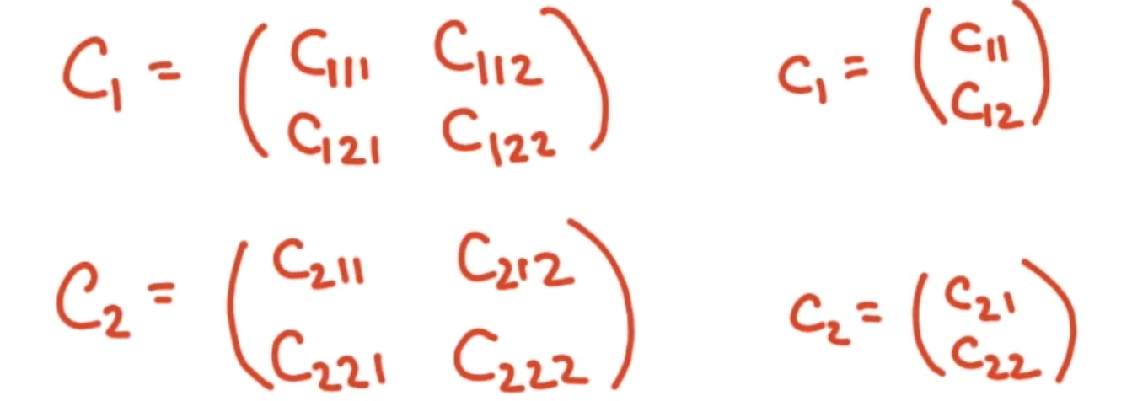
Lec-144: Space Partition Constraints Example
Only data dependencies:
X[i, j] $↔$ X[i, j-1] (I)
Y[i-1, j] $↔$ Y[i, j] (II)
12 unknowns
Could use previous knowledge that dimensionality of the processor space = 1 (C₁, C₂ have dependent rows)
For now, assume that C₁₂₁ = C₁₂₂ = 0 = C₂₂₁ = C₂₂₂

Slide 18
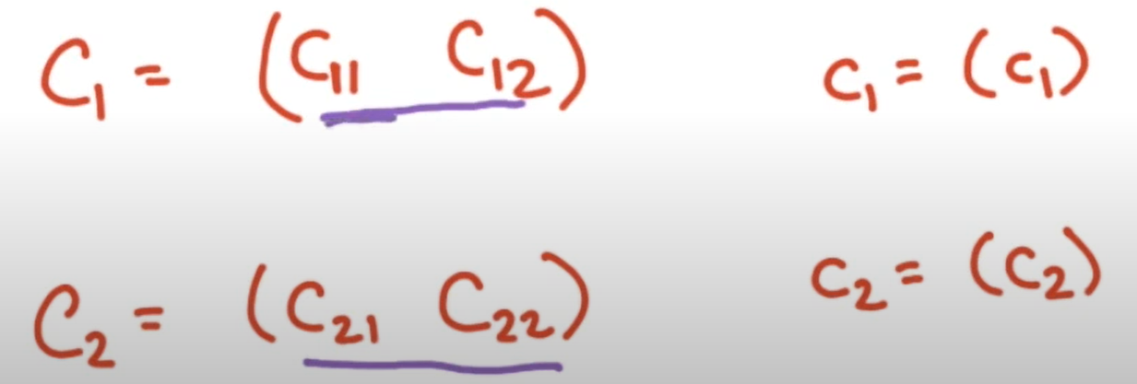
Space Partition Constraints Example
New Problem:

Slide 19
Space Partitioning Constraints
For dependency (I):
Possible Solution: C₁₁ = C₂₁ = 1, C₁₂ = C₂₂ = 0, c₁ = c₂ = 0
Iteration (i, j) is mapped to processor i
All conditions are satisfied (one of the possible solutions)
But this is not the only constraint

Slide 20
Space Partitioning Constraints
For dependency (II):
Possible Solution: C₁₁ = C₂₁ = 0, C₁₂ = C₂₂ = 1, c₁ = c₂ = 0
This solution satisfies the second dependency but not the first
Previous solution does not satisfy this dependency
Need a solution that satisfies both the constraints

Slide 21
Space Partitioning Example Solution
Solution: C₁₁ = C₂₁ = 1, C₁₂ = C₂₂ = -1, c₁ = -1, c₂ = 0
i – j – 1 = i’ – j’
This holds for both the constraints

Slide 22
Lec-145: Solving Space Partition Constraints
Both these constraints must be satisfied
i, j, i’, j’ are not unknowns

Slide 23
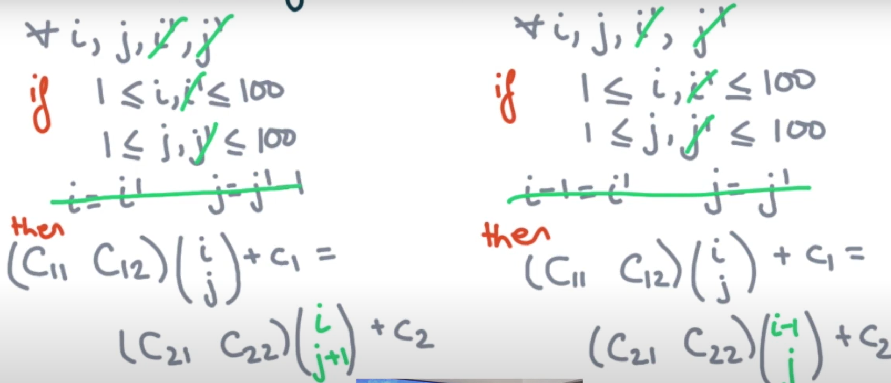
Solving Space Partition Constraints
Use gaussian elimination to get rid of some variables
Use the constrains to eliminate i’, j’

Slide 24
Solving Space Partition Constraints
Rewrite the equations:

Slide 25
Solving Space Partition Constraints
Overapproximate the behavior of iteration variables for these constraints
Assume that the equations hold for all real values of i , j
Which means that the coefficient of i, j and the constant term are zero
$$C11=C21$$
$$C12=C22$$
$$c1=c2+C22$$
$$c1=c2 −C21$$

Slide 26
Solving Space Partition Constraints
On solving, we get:
$$−C12=−C22=C21=C11=C$$
$$c1=c2−C$$
Actual constant values don’t matter because they only shift the space of processor IDs
WLOG, pick C = 1, c₂ = 0
So, we get the same solution as before
P₁ = i – j – 1
P₂ = i – j
Remaining: we need to make sure that all the iterations mapped to the same processor preserve the relative order of execution of these iterations

Slide 27
Thank You!
- Jai Arora

